Slide 1

Impact of COVID-19
on ALICE
Updated August 2020

Slide 2

United for ALICE
What we do:
Driver of innovation for ALICE households since 2007
Research team developed and updates a set of comprehensive measures of financial hardship
Data for all 3,000+ counties in U.S.
ALICE partners convene, advocate, and innovate in their local communities to highlight the issues faced by ALICE households and to generate solutions that promote financial stability
ALICE Recovery Fund
UnitedForALICE.org
Founded and Directed by the United Way of Northern New Jersey
Notes:
United For ALICE is a driver of innovation, shining a light on the challenges that ALICE (Asset Limited, Income Constrained, Employed) households face and finding collaborative solutions. Through a standardized methodology that assesses the cost of living in every county, this project provides a comprehensive measure of financial hardship across the U.S. Equipped with this data, ALICE partners convene, advocate, and innovate in their local communities to highlight the issues faced by ALICE households and to generate solutions that promote financial stability. This grassroots movement represents United Ways, corporations, nonprofits and foundations in Arkansas, Connecticut, Florida, Hawai‘i, Idaho, Illinois, Indiana, Iowa, Louisiana, Maryland, Michigan, New Jersey, New York, Ohio, Oregon, Pennsylvania, Tennessee, Texas, Virginia, Washington and Wisconsin; we are United For ALICE.
Vision: We envision a world where all those who work to keep our economy running can support themselves and their families
Mission: Become the standard measure used by nonprofit, government, business, and academic institutions to define financial insecurity; change the common vernacular from “working poor” to “ALICE”
What we do:
Conduct research and produce reports: We provide unbiased data that is replicable, updated regularly, and sensitive to local context
Lead a learning community: We facilitate a forum for sharing experiences, developing best practices, and building broader impact and fundraising strategies
Inspire action: Our ultimate goal is to stimulate action that will improve the financial stability of ALICE families and their communities

Slide 3
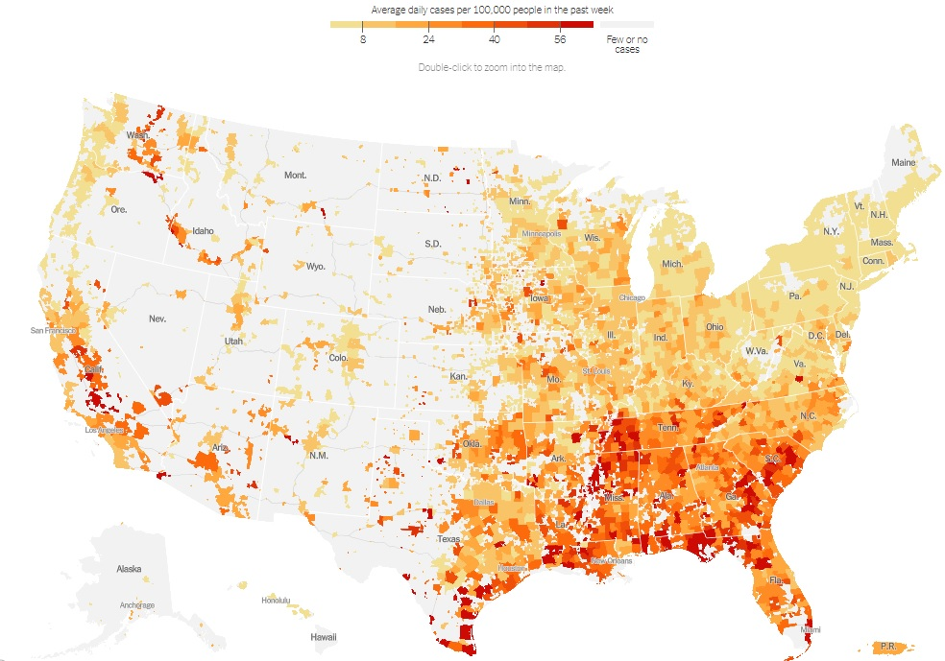
Overview: ALICE and COVID-19
Who is ALICE?
COVID-19 crisis is unprecedented
Impact on:
  Children and Families
  Seniors
  Workers
Lessons from Superstorm Sandy, Great Recession
Next steps
Average Daily Cases Per 100,000
UnitedForALICE.org/COVID19
Source: NYTimes, Coronavirus in the US: Latest Map and Case Count, 8/3/2020
Notes:
This map is updated daily. Go to link and copy map if we want to insert a more recent version.
The New York Times, Coronavirus in the U.S.: Latest Map and Case Count, 8/3/2020
https://www.nytimes.com/interactive/2020/us/coronavirus-us-cases.html

Slide 4
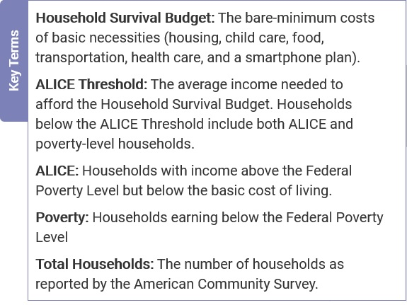
Who is ALICE?
Asset Limited, Income Constrained, Employed
Above FPL, below Household Survival Budget
Low-wage jobs – cashiers, health care workers, security guards, laborers, office administration
No savings…
  For emergencies
  For investing in the future – education, homeownership, retirement

Slide 5
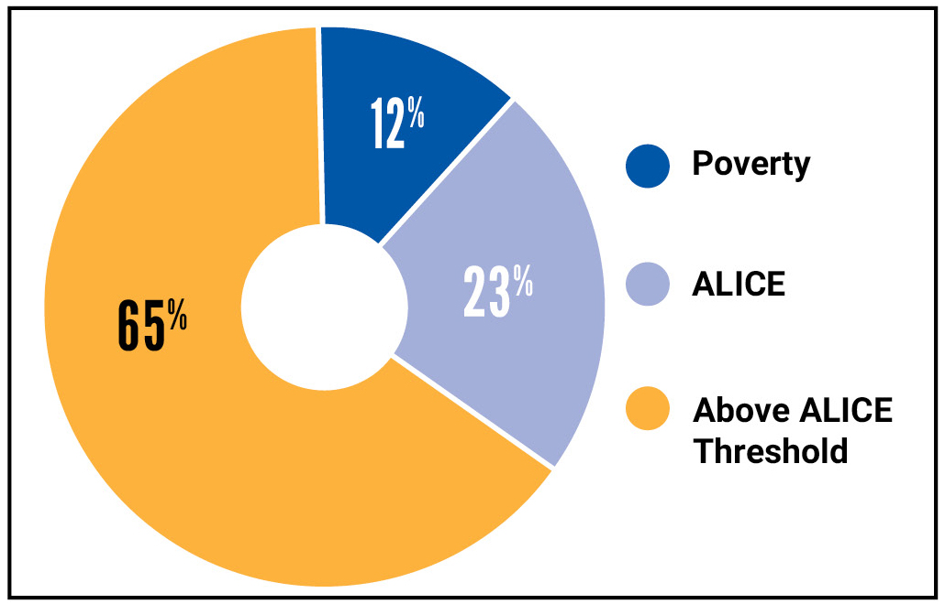
COVID-19 Crisis is Unprecedented
35% of households in STATE were already vulnerable before the pandemic
  12% of households were in poverty
  23% of households were ALICE
The number of ALICE households will increase
  Rising unemployment
  Closed businesses
  Halted production of goods/services
Inequalities are exacerbated by the pandemic
Households by Income, Illinois, 2018
Sources: ALICE Threshold, 2018; American Community Survey, 2018
Notes:
Groups that are disproportionately ALICE will be impacted even more severely. Many ALICE families have been skimping on essentials for years, from healthy food to routine health care. Along with the added stress of living paycheck to paycheck, these factors increase the risk for chronic health conditions, making ALICE even more vulnerable during a public health crisis (see United For ALICE’s 2019 Report, The Consequences of Insufficient Household Income). Initial reports are showing that groups that have underlying health conditions, face persistent discrimination in health care services, or live in areas with fewer support services (health care deserts and rural areas) make up a higher proportion of COVID-19 deaths.

Slide 6

COVID-19 Crisis is Unprecedented
35% of households in STATE are vulnerable
Dual impact:
  Health of individuals: 30% to 70% of U.S. population projected to become infected
  Economic capability of workers and businesses is diminished
All regions of the country impacted simultaneously
Notes:
Boyle, A. (2020, March 26). Univ. of Washington researchers predict 80,000 COVID-19 deaths in U.S. by July. GeekWire. Retrieved from
https://www.geekwire.com/2020/univ-washington-epidemiologists-predict-80000-covid-19-deaths-u-s-july/
Modeling from Imperial College COVID-19 Response Team

Slide 7
Families With Children and College Students
School closures have a significant impact on families with children and college students
  Disruption to normal life - meals, socialization, learning
  For some children, school is their one safe place
  Having children at home limits parents’ ability to work
  Digital divide – gap in access to internet and technology
  College students – online learning challenges, loss of housing/meals, jobs
  Many school and college staffers are ALICE workers
Notes:
COVID-19 and families with children:
Disruption to normal life – free and reduced-price lunches, education, routines, stability
For some children, school is their one safe place – sheltering at home can lead to unsafe situations in families where there is neglect and/or abuse
Ability of parents to work from home is limited when they need to care for children/assist with remote learning
Digital divide: ALICE households are less likely to have high-speed internet access and digital tools. With less access to the internet and computers, ALICE children will have difficulty participating in online learning and parents have more difficulty working remotely (if that’s an option)
College students: many work – and lost their jobs, many don’t have another home to go to
ALICE school employees: ALICE also works at schools and colleges – as support staff, transportation, custodial staff, and teachers working multiple jobs to make ends meet. School support positions that are outsourced through third-party vendors may not be compensated during school closures.

Slide 8
Seniors: The Most Vulnerable Age Group
Almost half of seniors are below the ALICE Threshold and face unique challenges
  Stock market decline will reduce retirement funds
  Seniors often live in group quarters with higher infection risk
  Delays in non-essential care cause/exacerbate health issues
  Increased isolation
    Restricted visiting to senior housing
    Closure of senior centers
  ALICE caregivers, paid and unpaid
    More responsibility, fewer supports
  Disrupted medication supply chain
Notes:
Half [ADJUST FOR YOUR STATE] of seniors are below ALICE Threshold: [ADD NUMBERS FOR YOUR STATE] XXX out of XXX senior households are below the ALICE Threshold
Stock market decline will reduce retirement funds – seniors relying on investments will be impacted. With the projected time horizon, probably won’t have time to recoup these losses
Seniors often live in close conditions – retirement homes, nursing homes – with greater risk of infection
Hold on non-essential care – many won’t get care they need, from physical therapy to elective/minor surgery
Isolation – already a problem for many seniors. Social distancing increases isolation and can exacerbate mental health issues and dementia
Senior centers closed in communities – reduces access to hot meals and socialization, and increases burden for family caregivers
Increased risk for grocery shopping and visits to the pharmacy
ALICE caregivers, paid and unpaid – more responsibility with fewer supports
Disruption in medication supply chain – many generic medications are produced in China

Slide 9
ALICE Essential Workers: Low-Wage, High-Risk
Essential Workers are at Risk
Many ALICE jobs are critical now; workers vulnerable to illness
    Health care workers
    Grocery store clerks
    Limited protective gear
Many essential workers also have additional family caregiving responsibilities
No safety net = no choice but to work
Higher levels of stress
#EssentialALICE
Notes:
Overview: ALICE workers play essential roles in state and national economies, building and repairing our infrastructure and educating and caring for our past, current, and future workforce. Many are in the trenches caring for COVID-19 patients. Yet many ALICE workers do not have basic employee protections — such as annual salary, health coverage, paid sick leave, and other benefits — that would help them withstand the COVID-19 crisis.
Workers in low-wage jobs face new and greater risks. On one hand, many of these jobs are now deemed “essential,” and employees are asked to report to work despite risk to their health. On the other hand, many of these jobs are seen as “dispensable,” and workers have their hours cut or are laid off, losing wages as well as benefits (if they had them to begin with)
Essential workers — concern for low-wage workers’ protection, risk, safety
Many Nurturer jobs are critical now, yet these workers are vulnerable to illness
Maintainer Occupations:
Infrastructors build and maintain the physical economy (construction, maintenance, management, administration, manufacturing, agriculture, mining, transportation, retail).
Nurturers care for and educate the workforce (health and education, food service, arts, tourism, hospitality).
Innovator Occupations:
Adaptors implement existing tools or processes in new ways, responding to opportunities and changing circumstances (managers, industrial and organizational psychologists, analysts, designers, technicians, and even policymakers).
Inventors devise new processes, appliances, machines, or ideas. Before World War II, most inventors were independent entrepreneurs. Today, they are most likely engineers and scientists working in research & development, and in some cases in higher education.

Slide 10
ALICE Non-Essential Workers
Non-essential workers face job insecurity
Half of jobs are hourly paid – most vulnerable
Many households don’t have savings to withstand reduced income
Digital divide – gap in who can work from home
Unemployment reaching new levels
  Even more ALICE jobs not captured in unemployment statistics
    Self-employed, “side-hustles”
Infrastructure maintenance being deferred, will cause problems in the future
  Will take months/years to ramp up infrastructure jobs
Notes:
Non-essential workers facing long-term unemployment
Infrastructure not needed now — stores closed, events cancelled, businesses closed
Will take time to ramp back up — restaurants close, replaced with new one
Long-term wage depression — workers ready, jobs will take time
Nationwide, half of jobs are hourly paid – and are most vulnerable to the immediate impact of economic disruption
40% of households don’t have $400 savings (US) – no cushion to withstand reduced income
Digital divide – makes it harder for ALICE to work from home (if they even have the option)
Even more ALICE jobs not captured – such as those who are self-employed. Also, as many as 40% of worker have one or more “side-hustles” to help make ends meet (US). Many of those opportunities are closed during social distancing.
With nonessential business and work closed, much ongoing maintenance is being deferred. As anyone with an old house knows, this causes larger problems in the future.
With so much of the economy closed down, and a vaccine 18 months away, re-creating these jobs will take months, even years.
Job projections for low-wage workers:
Historic number of unemployed – millions of workers filing for unemployment
Lost wages –- rarely tallied, but total billions of dollars
The Federal Reserve estimated 53 million unemployed persons in March. Since we made March the baseline, our first month of COVID-19 unemployment was April; we estimated about 47 million unemployed.
Federal Reserve. (2020, March). Back-of-the-Envelope Estimates of Next Quarter’s Unemployment Rate. Retrieved from https://www.stlouisfed.org/on-the-economy/2020/march/back-envelope-estimates-next-quarters-unemployment-rate
In the last two weeks of March, more than 371,000 people filed claims:
https://www.nj.com/coronavirus/2020/04/nj-unemployment-claims-surge-by-205000-as-coronavirus-toll-rises.html

Slide 11
ALICE Measures Help Guide Policy
Household Survival Budget – can be used as eligibility criterion for assistance
  Essential budget items highlight areas of need
Percent below ALICE Threshold by geography – areas to target assistance
Groups that are disproportionately ALICE are more vulnerable to COVID-19 impacts – by age, race/ethnicity, household type
ALICE families face additional expenses – increased health care costs, quarantine costs, food
Notes:
Household Survival Budget can be used as a realistic level of eligibility for assistance
Where there are high percentages of households below ALICE Threshold, additional assistance is likely needed
Groups overrepresented as ALICE are vulnerable to COVID-19 – age, race/ethnicity, HH type. This is especially topical with the reports of African Americans dying at higher rates than other groups. Unfortunately, states do not seem to be keeping track of cases by income level
Many ALICE families face gaps in income due to extra health care costs, quarantine costs, eating more food at home (when meals used to be provided at school or work)

Slide 12
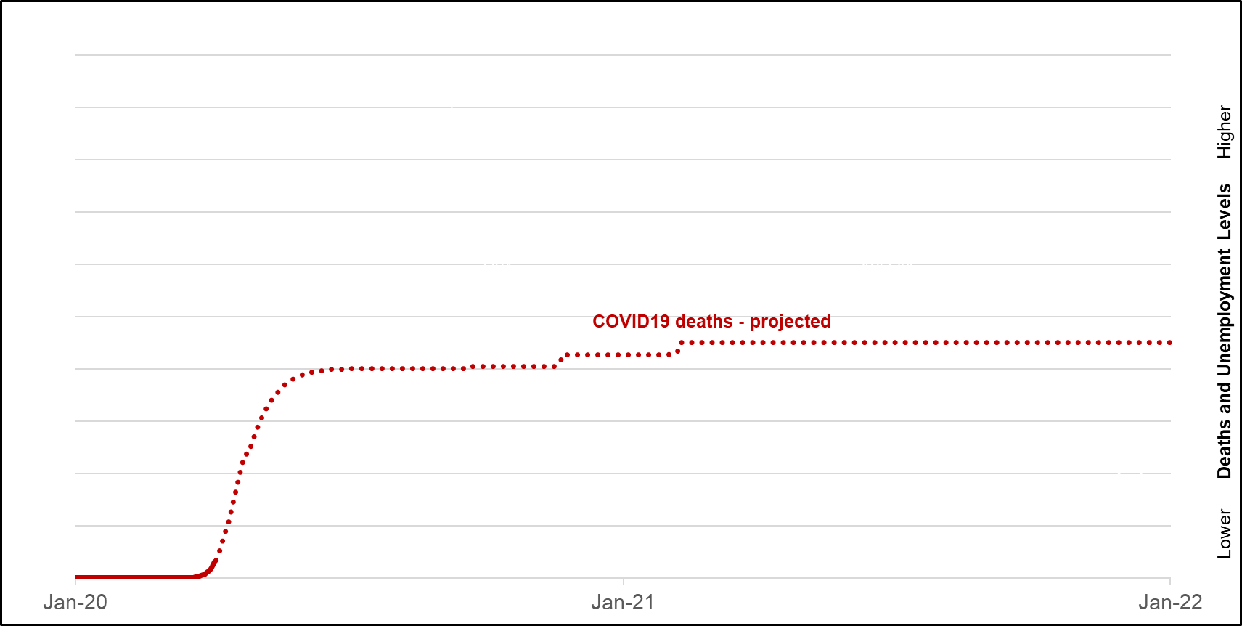
Phases of COVID-19 Disaster and Recovery
COVID-19 cumulative deaths - projected
COVID-19 cumulative deaths - Institute for Health Metrics and Evaluation at the University of Washington
Notes:
We are all following the daily updates of COVID-19 cases and deaths.
Several groups have made projections about the number of deaths over time. Presented here are the projected cumulative U.S. deaths from COVID-19 from January 2020 to January 2022 (adjusted to an index, right axis). Solid red are actuals, and dotted lines are projections from Institute for Health Metrics and Evaluation (IHME) is an independent population health research center at UW Medicine, part of the University of Washington. COVID-19 projections assuming full social distancing through May 2020 https://ourworldindata.org/coronavirus#the-growth-rate-of-covid-19-deaths

Slide 13
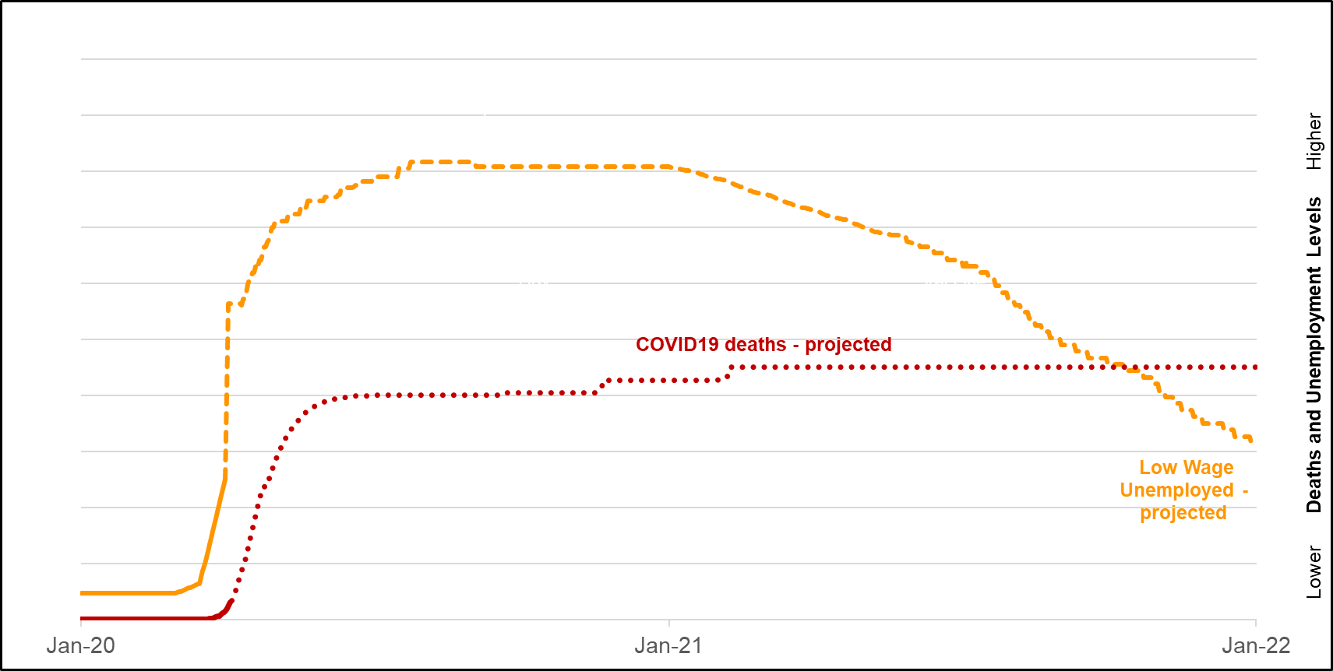
Phases of COVID-19 Disaster and Recovery
COVID-19 cumulative deaths - Institute for Health Metrics and Evaluation at the University of Washington
Low-wage job unemployment - BLS and ALICE Household Survival Budget
Notes:
The ALICE research team has divided occupations into low, medium, and high wage jobs based on their ability to support the Household Survival Budget.
Looking at the low-wage jobs, the team estimated unemployment based on their sector, determination as “essential,” and degree of public interaction. Unemployment of low-wage jobs is presented in yellow, solid are actual claims, dotted are projected. (The numbers have been adjusted to an index (right axis).
Sources: ALICE Household Survival Budget, 2018; Bureau of Labor Statistics, 2018—Occupational Employment Statistics
Additional sources:
http://filesforprogress.org/memos/the-staggering-economic-impact-coronavirus.pdf
Back-of-the-Envelope Estimates of Next Quarter’s Unemployment Rate: https://www.stlouisfed.org/on-the-economy/2020/march/back-envelope-estimates-next-quarters-unemployment-rate

Slide 14
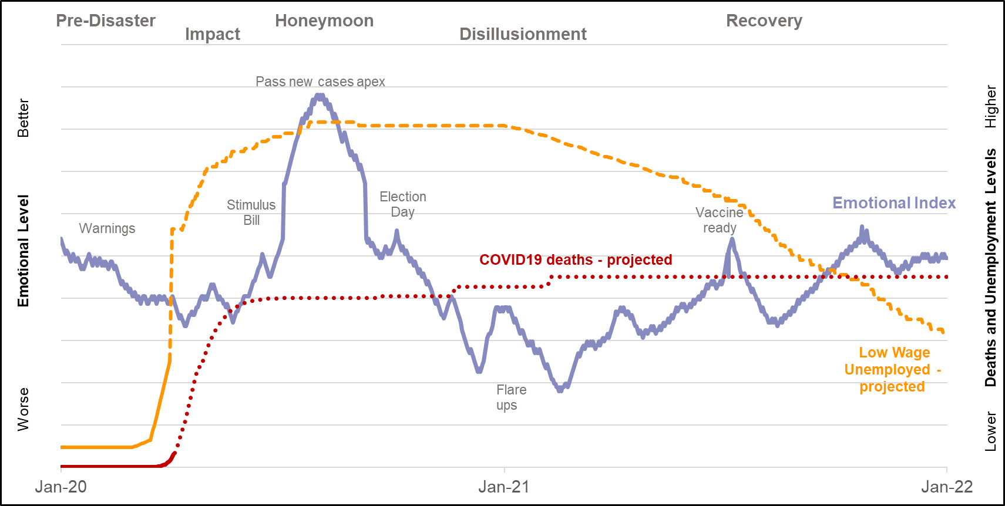
Phases of COVID-19 Disaster and Recovery
COVID-19 cumulative deaths - Institute for Health Metrics and Evaluation at the University of Washington
Low-wage job unemployment - BLS and ALICE Household Survival Budget;
Emotional Index - Zunin & Myers, phases of disaster
Notes:
While COVID-19 is unprecedented in many ways, patterns of disaster and recovery that have proven consistent through many different crises can offer some insight about what is ahead.
Adapting the Emotional Index developed by Zunin & Myers, we show the emotional highs and lows that normally follow a disaster.
Phase 1, the pre-disaster phase, is characterized by fear and uncertainty. There are often warnings which may be as short as hours, or as long as several months, such as during a hurricane season. The COVID-19 cases in China and Italy were warnings for what was coming to the U.S.
Phase 2, the impact phase, is characterized by a range of intense emotional reactions, ranging from shock to overt panic. Initial confusion and disbelief typically are followed by a focus on self-preservation and family protection. During COVID-19, we see this with families stocking up on cleaning supplies, masks and gloves, medicine, and food. The impact phase is usually the shortest of the six phases of disaster.
Phase 3, the heroic phase, is characterized by a high level of activity with a low level of productivity. During this phase, there is a sense of altruism, and many community members exhibit adrenaline-induced rescue behavior. During COVID-19, this is when major legislation is passed, large fundraising efforts established. The heroic phase often passes quickly into phase 4.
Phase 4, the honeymoon phase, is characterized by a dramatic shift in emotion. During the honeymoon phase, disaster assistance is readily available. Community bonding occurs. Optimism exists that everything will return to normal quickly. As a result, numerous opportunities are available for providers and organizations to establish and build rapport with affected people and groups, and for them to build relationships with stakeholders. The honeymoon phase typically lasts only a few weeks.
Phase 5, the disillusionment phase, is a stark contrast. Communities and individuals realize the limits of disaster assistance. Stress continues to take a toll, and negative reactions, such as physical exhaustion or substance use, may begin to surface. The increasing gap between need and assistance leads to feelings of abandonment. The disillusionment phase can last months and even years. It is often extended by one or more trigger events; for COVID-19, these are likely localized new coronavirus outbreaks.
Phase 6, the reconstruction or recovery phase, sees individuals and communities begin to assume responsibility for rebuilding their lives, and people adjust to a new “normal” while continuing to grieve losses. For COVID-19, recovery will likely begin when a vaccine is available, and will likely last for years.
Source: Zunin & Myers as cited in DeWolfe, D. J. (2000). Training manual for mental health and human service workers in major disasters (2nd ed., HHS Publication No. ADM 90-538). Rockville, MD: U.S. Department of Health and Human Services, Substance Abuse and Mental Health Services Administration, Center for Mental Health Services. Adapted by SAMHSA, 2020. https://www.samhsa.gov/dtac/recovering-disasters/phases-disaster

Slide 15
Phases of COVID-19 Disaster and Recovery
COVID-19 cumulative deaths - Institute for Health Metrics and Evaluation at the University of Washington
Low-wage job unemployment - BLS and ALICE Household Survival Budget;
Emotional Index - Zunin & Myers, phases of disaster
Notes:
There are several relevant lessons for weathering COVID-19 from the East Coast's experience of Superstorm Sandy, and from the Great Recession. First, while all households are impacted, ALICE families are the most vulnerable. In Superstorm Sandy, ALICE families lived in blue-collar neighborhoods that were prone to flooding; they lost two to three weeks of wages when their hourly wage jobs were cancelled due to lack of electricity and road closures; and they were far less likely to have resources such as savings or insurance (homeowners or flood). During the Great Recession, many ALICE workers lost their jobs, their savings, and/or their homes.
Second, it took ALICE families much longer to recover. After Superstorm Sandy, many ALICE families were forced to move away from their damaged homes and communities, spending meager savings on travel and remote housing. Those who worked in tourism and hospitality at the Shore waited months for their jobs to come back. Some ALICE homeowners still had not returned to their homes six years after the storm. After the Great Recession, unemployment remained above 8% until September 2012. And while many ALICE workers were rehired in the year or two following the Recession, their new jobs paid lower wages.
Third, the period of disillusionment was especially hard for ALICE families. After Superstorm Sandy, many ALICE families felt like for the first time, their pain was acknowledged when FEMA responded swiftly, and ALICE Recovery Funds were quickly established. However, in the months and years after, their flood insurance claims were underpaid or rejected, and FEMA demanded clawbacks. Similarly, after the Great Recession, there were enormous government spending programs, notably the $800 billion American Recovery and Reinvestment Act and the $700 billion Troubled Asset Relief Program. However, the majority of these funds went to tax cuts, bank assets, and corporate bailouts. ALICE workers’ wages never fully recovered.

Slide 16
Government Actions to Assist ALICE
Immediate income to offset ongoing bills –include gig workers
  Unemployment
  Cash payments
Health care
  Paid sick leave
  Coverage for health expenses
Housing
  Rent/mortgage freezes
  Moratoria on evictions and foreclosures
Debt and credit cards
  Relief for student loans
  Suspend credit card late fees
Jobs to go back to
  Small businesses
  Industry bailouts
  Works programs
Notes:
State Partners: Tailor to your state and include initiatives that you support. Here are some ideas…
Government actions:
Immediate income to offset ongoing bills – for everyone, include gig workers (not just W-2 employees) such as in the federal CARES Act
Unemployment, cash payments – there will be ongoing need, not one-time
Access to internet and technology
Health care: Paid sick leave; coverage for health expenses beyond COVID-19
Housing: Rent/mortgage freezes; moratoria on evictions and foreclosures
Debt and credit cards: Student loans, credit card
Jobs to go back to: Focus on small businesses; other possibilities include job sharing, industry bailouts, Works programs – WPA, civilian conservation program, bridges

Slide 17
Business Actions to Assist ALICE
Jobs – present and future
  Job-share, flexible hours, shift rotations
  Safety measures, new cleaning protocols
  Work-from-home support and technology
  Increase in hourly rate for essential workers
  Provide free back-up care for dependents
  Continue to pay during closed/suspended service
Health Care
  Paid and unpaid sick leave
  Paid leave for workers in risk groups
  Maintain health insurance
Internet Companies
  Access to internet and technology
Community Support
  Relief funds
  Food bank support, beverages, meals
  Supplies for health care professionals
Notes:
State Partners: Tailor to your state and include initiatives that you support. Here are some ideas…
Business Actions
Jobs – businesses are key to jobs now and in the future
Instead of unemployment, companies could offer job share, flex hours, and/or rotations
Many jobs will need new safety measures and cleaning protocols
Working from home will require new tools, routines, and support
Many have called for companies to increase the hourly rate for essential workers facing increased risk
Free back-up care for dependents could help make it possible for essential workers to go to their job
Continued pay during closed/suspended service may be possible with CARES act
Since most workers still get their health insurance through their employer, continuation during this crisis will be critical. Companies can also contribute to better health through paid and unpaid sick leave, paid leave for workers in risk groups
Internet companies can provide access to the internet and technology for workers and students who currently do not have service
Companies can also support the local communities where their employees and customers are located by contributing to relief funds and food banks, and donating supplies for health care professionals & EMS responders

Slide 18
Next Steps: Action for ALICE
Messaging – internal and external
Check webpage for latest updates: www.UnitedForALICE.org/COVID19
Make the case for ALICE in your community
ALICE Recovery Fund
Immediate needs
Long-term recovery
Social Media: @United4ALICE on Twitter and Facebook
#HelpALICE #EssentialALICE #UnitedForALICE
#ActionForALICE #MeetALICE #ALICErecovery

Slide 19
www.UnitedForALICE.org

